Slide 1

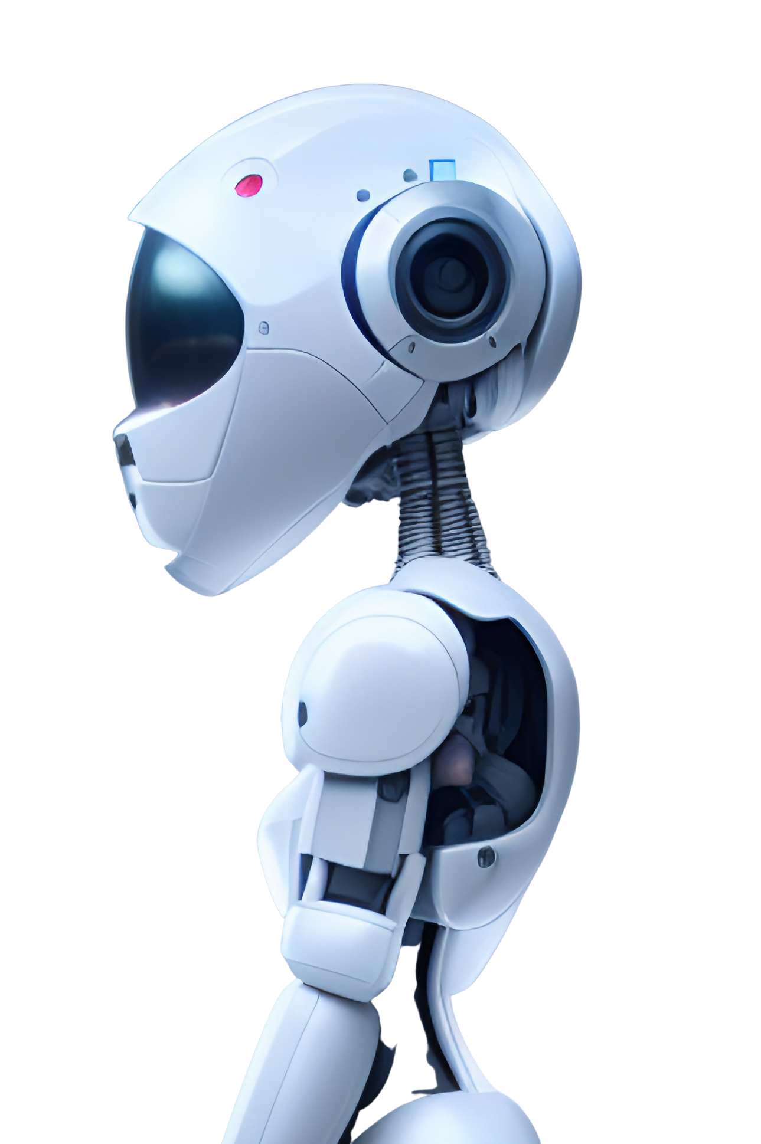


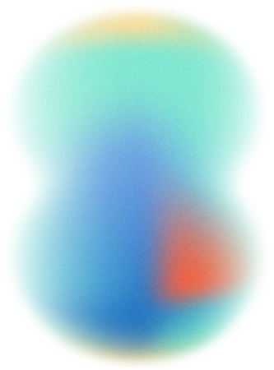
Coding AI
Age & Gender Detection
Pavan Snehal Trivedi
21002171210190
C-1
CSE
142

Slide 2

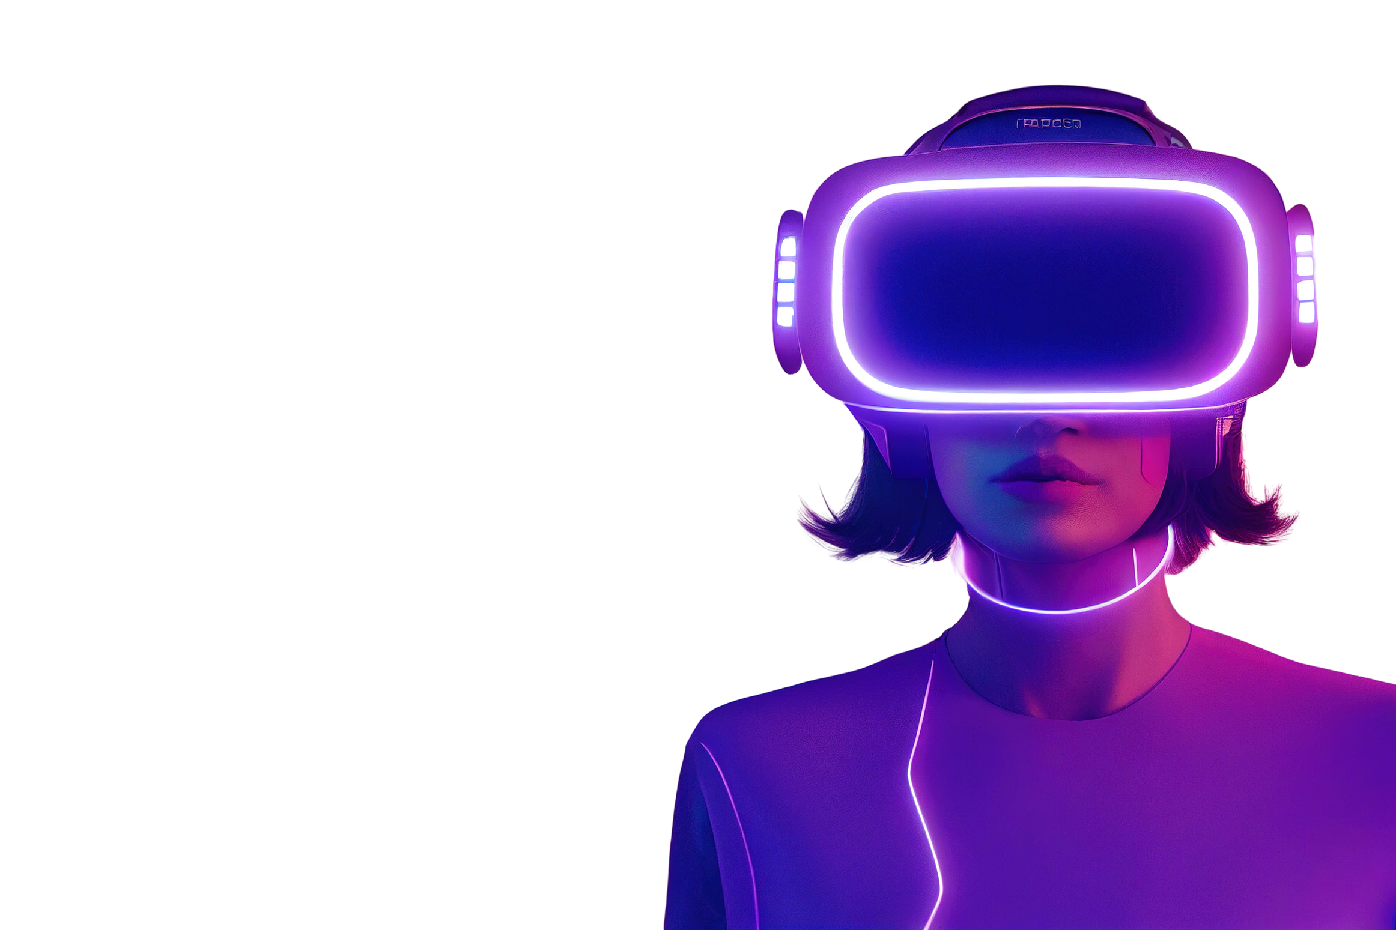
Introduction
Age and gender are fundamental facial attributes that significantly influence social interactions.
Estimating these attributes from a single face frame is crucial for intelligent applications such as access control, human-computer interaction, law enforcement, marketing intelligence, and visual surveillance.
Face Detection: The process of identifying and locating human faces within images or videos.
Gender Detection: Determination of an individual’s gender based on facial cues and structure.

Slide 3

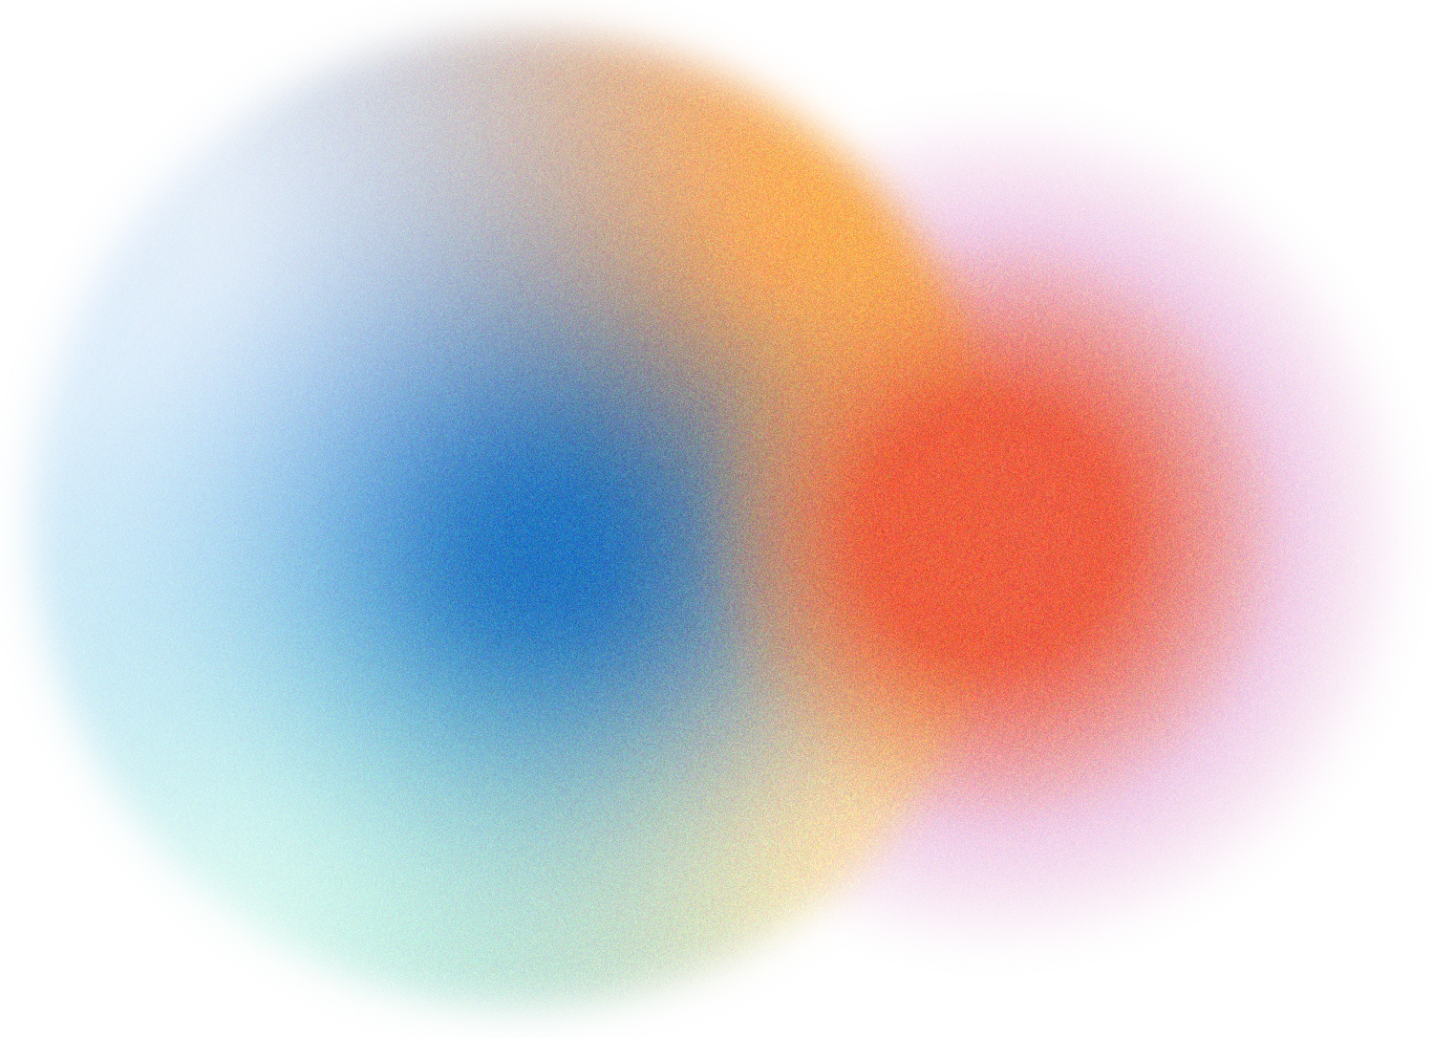
Objectives
Use the model and expose it in as API using web frameworks.
To pre-train the age & gender detection model using public Datasets such as UTKFace.
Goals: Develop an almost accurate face detection system.
Implement a reliable gender detection mechanism
Use facial images to detect the age & gender provided to the model.
Anticipated results: Improved security measures, enhanced marketing strategies and better human-computer interaction.

Slide 4
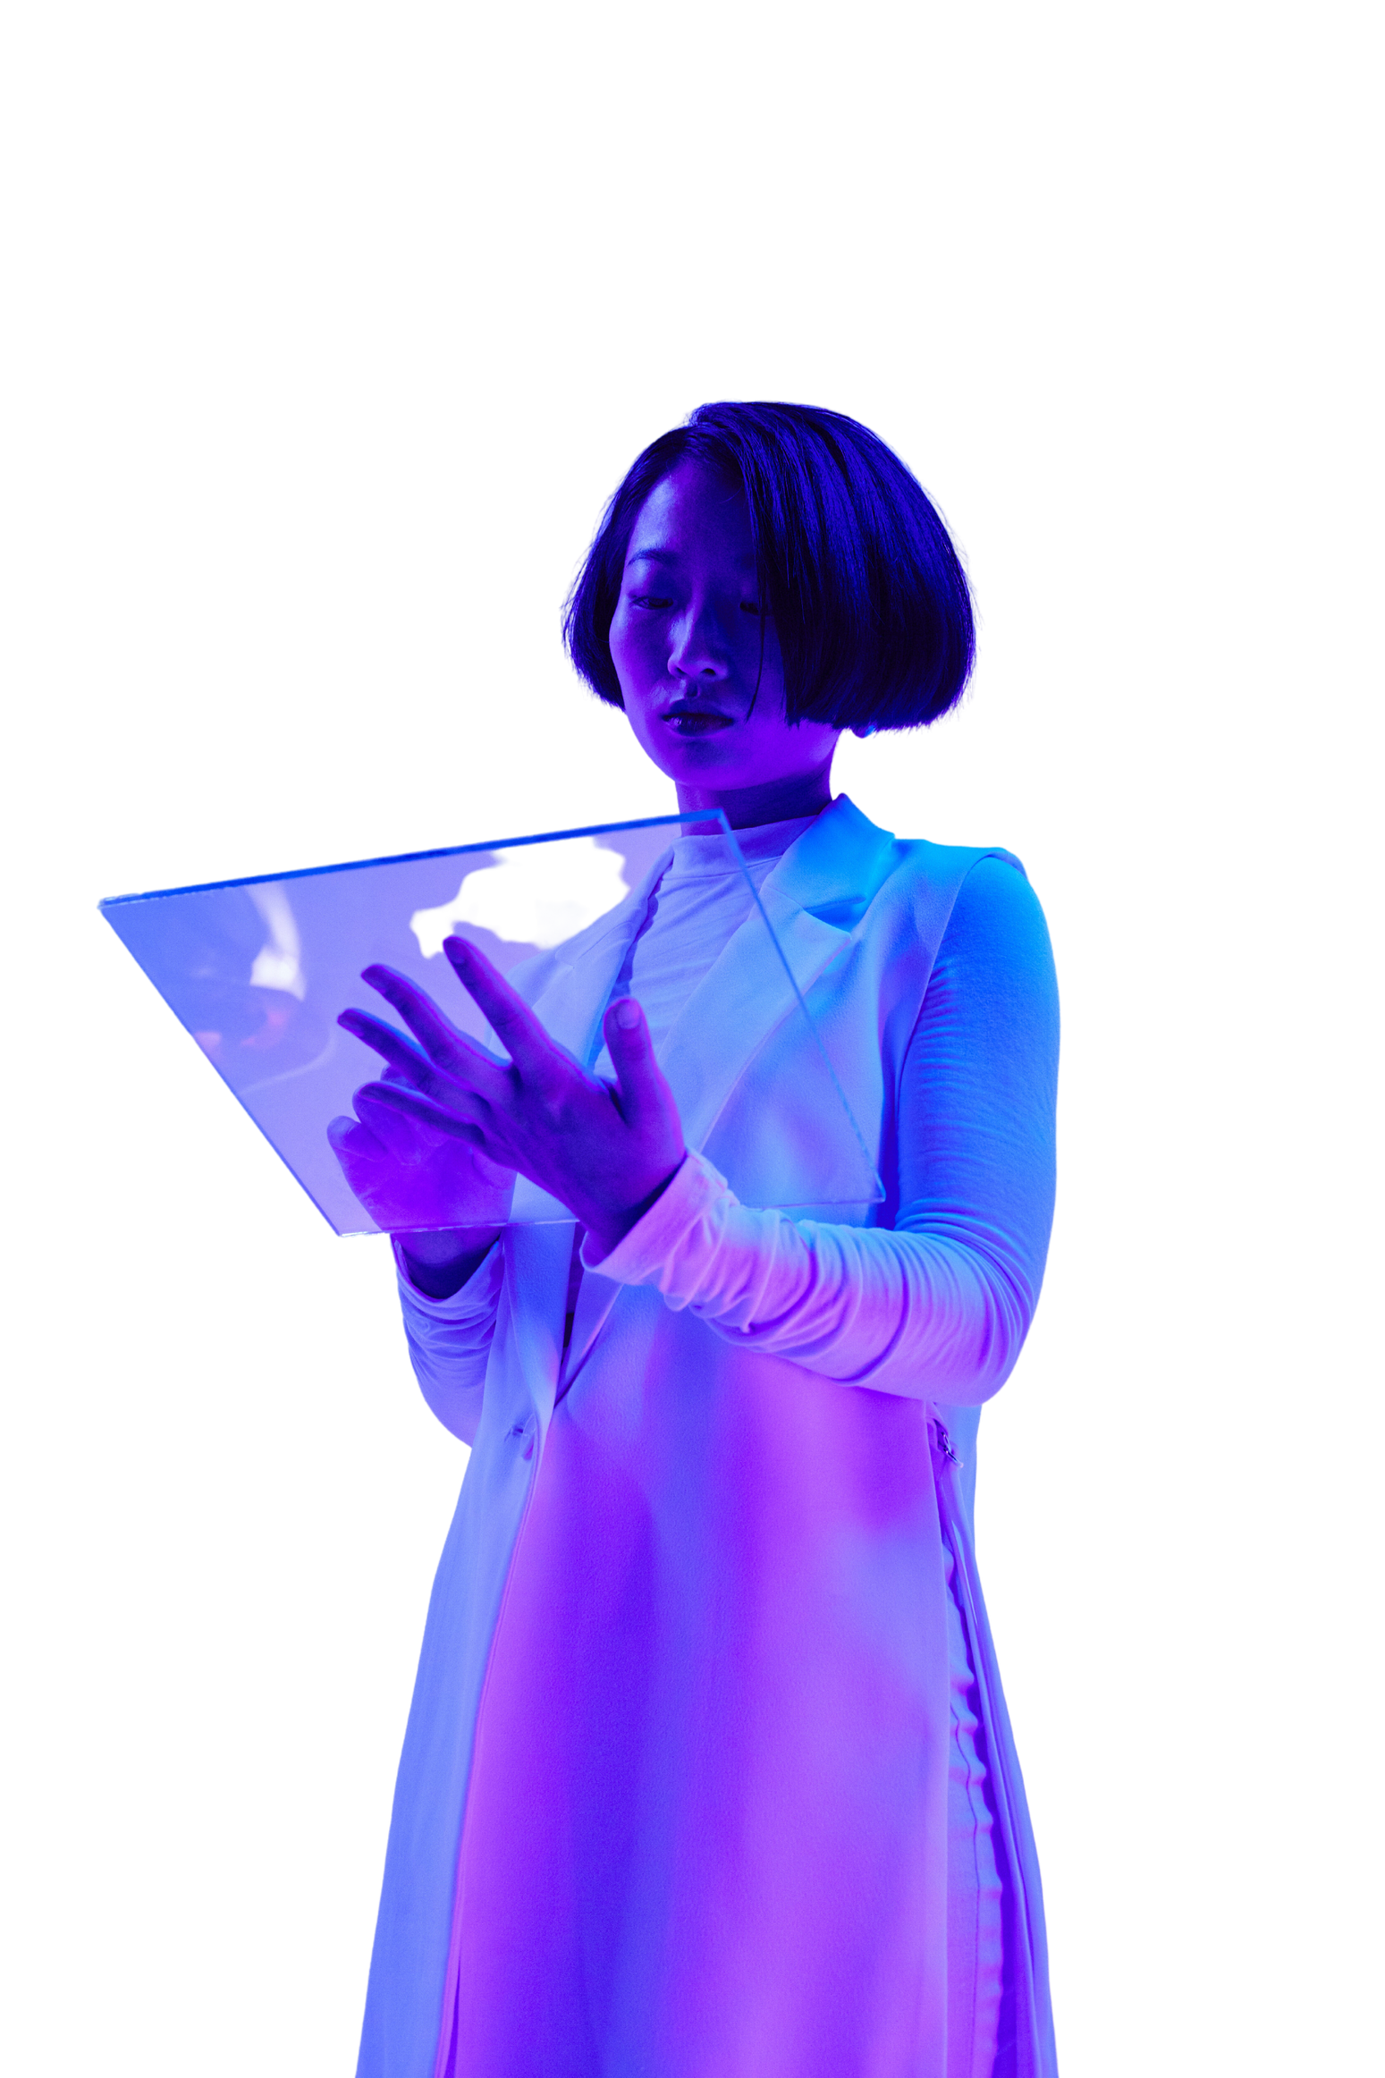
Technology Stack
ML Algorithms
Neural Networks
SVM,KNN, Decision Trees
CNNs, RNNs
Deep Learning
Tools
Enhanced accuracy and capability for complex tasks
OpenCV, TensorFlow

Slide 5

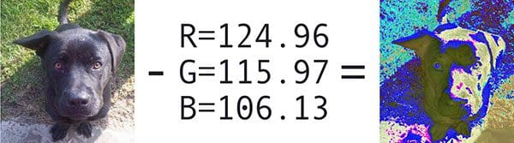
OpenCV
Open Source Computer Vision(OpenCV) is a library capable of processing real-time frame and video while also displaying analytical capabilities.
Used to display text on picture using putText(). imshow() is used to output the frames.
Cv2.dnn.blobFromImage function returns a blob which is our input image after mean subtraction, normalizing and channel swapping.
It was originally developed in C++. In addition Python and Java bindings were provided
OpenCV runs on various OS such as windows, Linux, OSx ,etc.
Some Features of the OpenCV Library:
Read & Write frames
Capture & Save videos
Perform Feature Detection
Detect specific objects(faces, eyes, cars, etc)
Analyze and track objects in a video
Mean subtraction where rgb mean is calculated from a dataset of images and subtracted from original image.

Slide 6
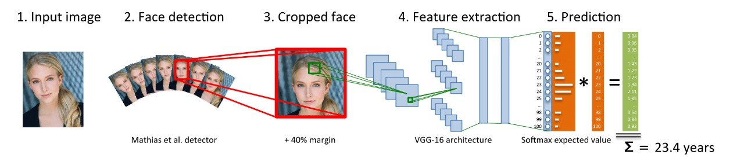
CNN(Convolutional Neural Networks)
A CNN is a deep neural network(DNN) widely used for the frame recognition purposes and processing NLP.
Also known as ConvNet, a CNN has input and output layers, and multiple hidden layers, many of which are convolutional.
It has 2 fully connected layers , each with 512 nodes and a final output layer of SoftMax type.
During training, the CNN learns the optimal values for filter matrices which enable it to extract meaningful features from input feature.
Convolutional Layers:
96 nodes, kernel size – 7
256 nodes, kernel size – 5
384 nodes, kernel size – 3

Slide 7





Methodology
Load Dataset
Train-test split
Data pre-processing
Building CNN
Test & Deployment
01
02
03
04
05
Notes:
© Copyright PresentationGO.com – Free Templates & Infographics for PowerPoint and Google Slides

Slide 8
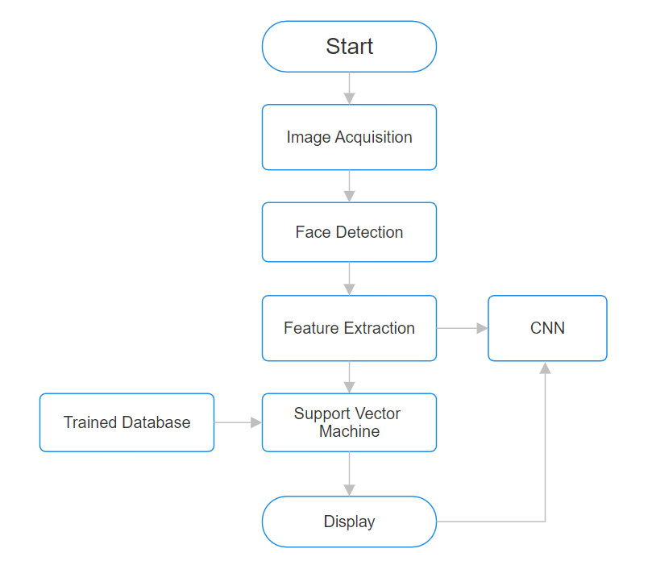
Flowchart

Slide 9
Steps involved in Face Detection
Detect Faces
When given a frame/video, CNN algorithm looks for faces in each frame.
Classify in Male/Female
Once a face is found, the features of the faces are extracted & gender is determined
Classify into one of the 8 ranges
The age of the faces is determined and fallen under either of the 8 ranges.
Display results
The resulting frame consists of a square box around the faces with estimated gender and age

Slide 10
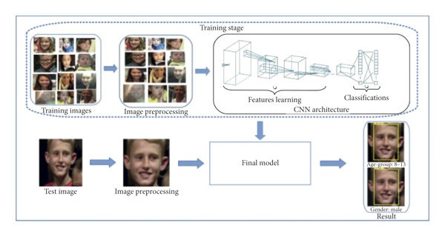
Here we will take a frame as an input and the algorithm will determine the age and gender of the individual in the frame. Age is divided into 8 different ranges [(0-2),(4-6),(8-12),(15-20),(25-32),(38-43),(48-53),(60-100)] and the output age will fall into one of them. While the gender will be either male or female.

Slide 11
Applications
Security & Surveillance
Marketing Intelligence
Human-Computer Interaction
Enhance security through facial recognition
Targeted Advertising based on gender detection
Improving user interfaces through personalized interactions

Slide 12
Future Scopes
To improve the accuracy, a dataset with more number of images can be provided.
Algorithm can be improved to an extent where it can be able to process and output the desired result on images with disturbances like lack of clarity, different angles, accessories worn on the face.
Example: If a person is wearing sunglasses or has makeup on the face, the algorithm should be able to give the desired result.

Slide 13
THANK YOU

